Slide 1
Diagram for Bitwise Right Shift Operator
Diagram for Bitwise Right Shift Operator

Slide 2
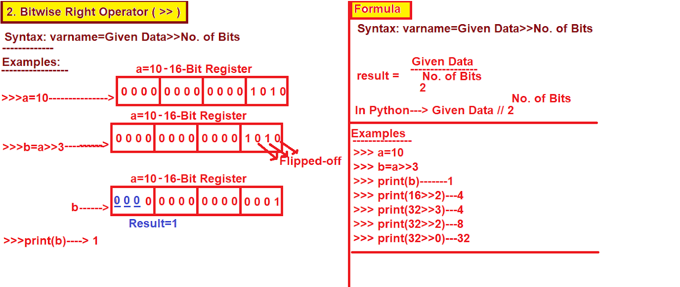
Diagram for Bitwise Right Shift Operator

